Slide 1
Union in C.

Slide 2
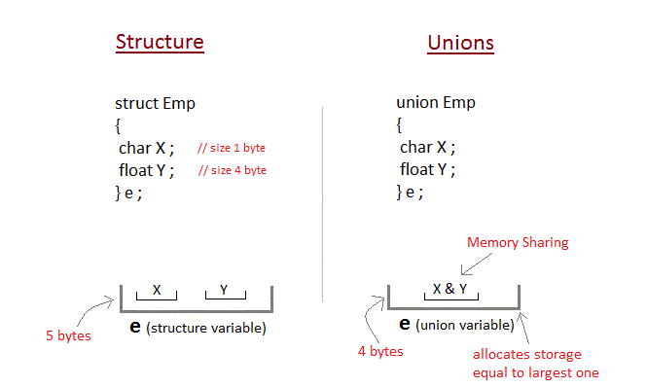

In structure, each member has it’s own storage location.
In Union, all the members share the same memory location.
We can define a union with many members of different data types.
But only one member can contain a value at any given time.

Slide 3
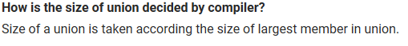
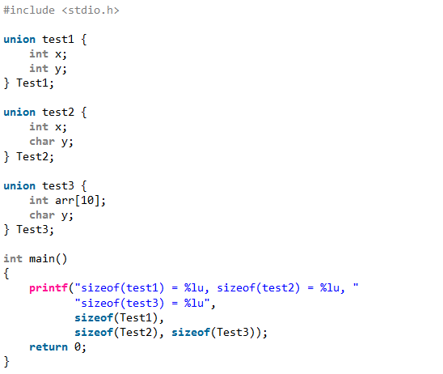
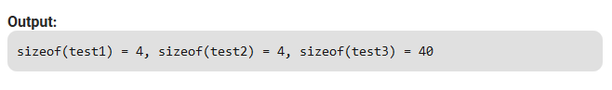

Slide 4
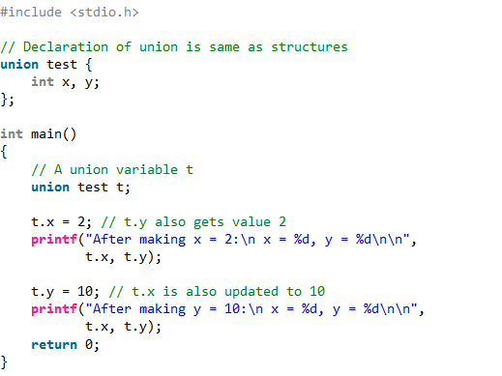
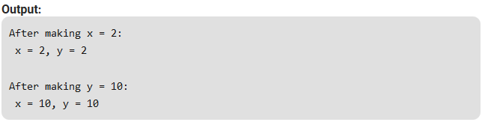

Slide 5
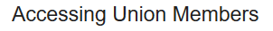
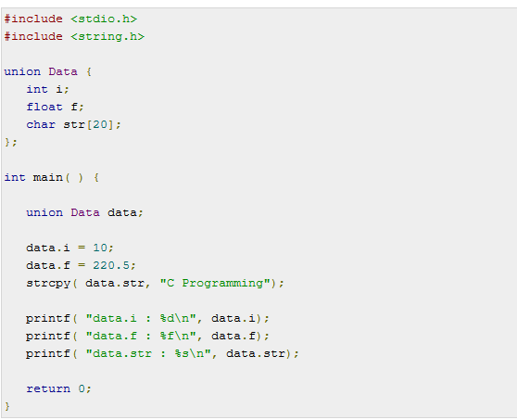
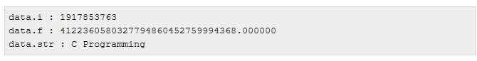
Output
Here the values of ‘i’ and ‘f’ members of the union got corrupted .
This is because, the final value assigned to the variable has occupied the memory location.
Thus the value of ‘str’ member only got printed correctly.

Slide 6
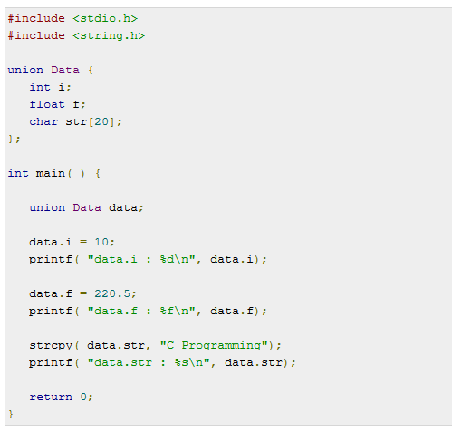
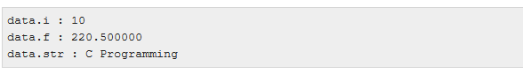
Output
Here all the members are getting printed.
This is because only one member is being used at a time.

Slide 7
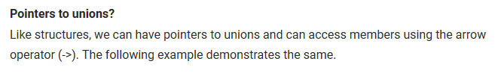
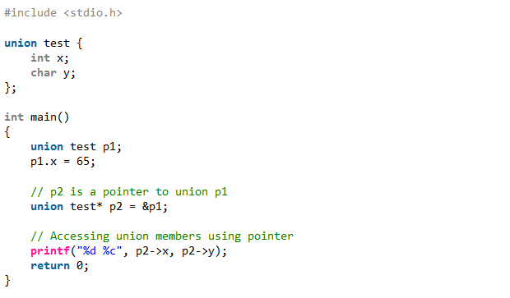
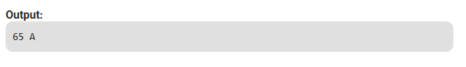

Slide 8
Thank You

